Slide 2
Generators – let us set up your project!
Arkadyuti Sarkar
Ayan Dalal
MAY 26, 2017

Slide 3
Agenda
What? Why? How?
What is Yeoman? Why not Yeoman?
Demo
Code walk
Repo details
Good-to-have features
Q/A session

Slide 4

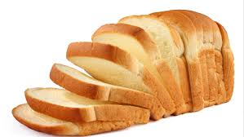
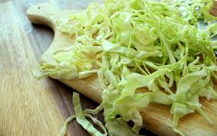
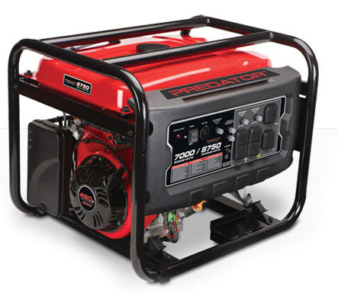
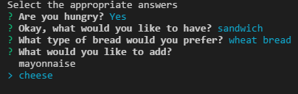
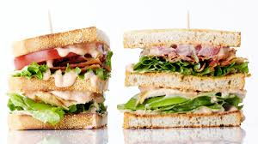

What are Generators?
Generators are an awesome way to kick start your application.
Prompts
calls prompts
answers
Generated project
YUMMY!! :P

Slide 5
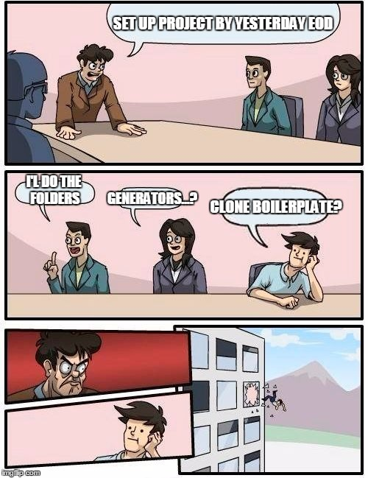

Why Generators?
Setting up a new project from scratch!
A hectic job!
Time consuming
Complex folder structure
Configuration of files
Innumerous trial-n-errors!
BANGING HEAD ON DESK

Slide 6
How?

Slide 7
What is Yeoman?
Snapshot of package.json
"dependencies": {
"async": "^1.0.0",
"chalk": "^1.0.0",
"cli-list": "^0.1.1",
"configstore": "^1.0.0",
"cross-spawn": "^3.0.1",
"figures": "^1.3.5",
"fullname": "^2.0.0",
"got": "^5.0.0",
"humanize-string": "^1.0.0",
"inquirer": "^0.11.0",
"insight": "^0.7.0",
"lodash": "^3.2.0",
"meow": "^3.0.0",
"npm-keyword": "^4.1.0",
"opn": "^3.0.2",
"package-json": "^2.1.0",
"parse-help": "^0.1.1",
"read-pkg-up": "^1.0.1",
"repeating": "^2.0.0",
"root-check": "^1.0.0",
"sort-on": "^1.0.0",
"string-length": "^1.0.0",
"tabtab": "^1.3.0",
"titleize": "^1.0.0",
"update-notifier": "^0.6.0",
"user-home": "^2.0.0",
"yeoman-character": "^1.0.0",
"yeoman-doctor": "^2.0.0",
"yeoman-environment": "^1.6.1",
"yosay": "^1.0.0"
}
"dependencies": {
"async": "^1.0.0",
"chalk": "^1.0.0",
"cli-list": "^0.1.1",
"configstore": "^1.0.0",
"cross-spawn": "^3.0.1",
"figures": "^1.3.5",
"fullname": "^2.0.0",
"got": "^5.0.0",
"humanize-string": "^1.0.0",
"inquirer": "^0.11.0",
"insight": "^0.7.0",
"lodash": "^3.2.0",
"meow": "^3.0.0",
"npm-keyword": "^4.1.0",
"opn": "^3.0.2",
"package-json": "^2.1.0",
"parse-help": "^0.1.1",
"read-pkg-up": "^1.0.1",
"repeating": "^2.0.0",
"root-check": "^1.0.0",
"sort-on": "^1.0.0",
"string-length": "^1.0.0",
"tabtab": "^1.3.0",
"titleize": "^1.0.0",
"update-notifier": "^0.6.0",
"user-home": "^2.0.0",
"yeoman-character": "^1.0.0",
"yeoman-doctor": "^2.0.0",
"yeoman-environment": "^1.6.1",
"yosay": "^1.0.0"
}
"devDependencies": {
"gulp": "^3.6.0",
"gulp-coveralls": "^0.1.0",
"gulp-eslint": "^2.0.0",
"gulp-exclude-gitignore": "^1.0.0",
"gulp-istanbul": "^0.10.4",
"gulp-mocha": "^2.0.0",
"gulp-nsp": "^2.1.0",
"gulp-plumber": "^1.0.0",
"mocha": "^2.1.0",
"mockery": "^1.4.0",
"nock": "^8.0.0",
"nsp": "^2.2.0",
"proxyquire": "^1.0.1",
"registry-url": "^3.0.0",
"sinon": "^1.12.1"
}
A kind of a middleware which takes our code and talks to node(fs) to scaffold our application.
"devDependencies": {
"gulp": "^3.6.0",
"gulp-coveralls": "^0.1.0",
"gulp-eslint": "^2.0.0",
"gulp-exclude-gitignore": "^1.0.0",
"gulp-istanbul": "^0.10.4",
"gulp-mocha": "^2.0.0",
"gulp-nsp": "^2.1.0",
"gulp-plumber": "^1.0.0",
"mocha": "^2.1.0",
"mockery": "^1.4.0",
"nock": "^8.0.0",
"nsp": "^2.2.0",
"proxyquire": "^1.0.1",
"registry-url": "^3.0.0",
"sinon": "^1.12.1"
}
Why not Yeoman?
Heavy
30 + 15 = 45!!!!!!
Abstraction
Less customizable

Slide 8

Yeoman workflow
Scaffolds out a new application
Build System
Package Manager
It’s MAGIC!!!

Slide 9

WHAT IF I TOLD
YOU
Generator with native code
(NodeJs)
IT’S NOT A MAGIC

Slide 10
DEMO

Slide 11
CODE-WALK

Slide 12
Good-to-have features
“This was all we could do. But we plan to make it a much bigger project with many more features.”
Create sub-generators to generate components, or change file configurations.
Add trending frameworks like Angular2, Preact.
Support universal rendering.
Provide basic test cases with required testing frameworks(chai,mocha).
“You are most welcome to add your own ideas & contributions!!”

Slide 13
FEEL FREE TO CONTRIBUTE!
Repo url - http://bit.ly/node-generator
Clone, contribute & raise PR!
Don’t forget to star us if you liked our work ;)
Please do visit our VOX page - http://bit.ly/generator-doc
Share your ideas and feedback!
Lets work together to make it a bigger project!

Slide 14
Questions?
Feedback?

Slide 15
Thank You
Special thanks for sharing ideas & guiding us throughout –
Vinci Rufus
Visweshwaran Suryanarayanan
Bhumika Sharma
Nisheed Jagadish
Santhosh Sundar
Reach out to us -
Arkadyuti Sarkar
asarkar2@sapient.com
Ayan Dalal
adalal4@sapient.com

